Slide 1
Tailwind CSS Lecturer: ENG-WIRELESS

Slide 2
MAIN POINTS
What is tailwind CSS
Setting up Tailwind
Basic utilities: colors, spacing, borders
Typography: Font Size, Font Weight, Text Alignment & Decoration.
Width and Height: fixed size, responsive
Flexbox: Basic Flex Container, Flex Direction, Alignment(Practice Project: Navigation Bar)
Grid Basics: Grid Container, Fixed Columns, Different Gap Sizes, How Column and Spanning Works.
Responsive Design in Tailwind CSS

Slide 3
Tailwind CSS
Tailwind CSS is a utility-first CSS framework that lets you build designs directly in your HTML using predefined classes.

Slide 4
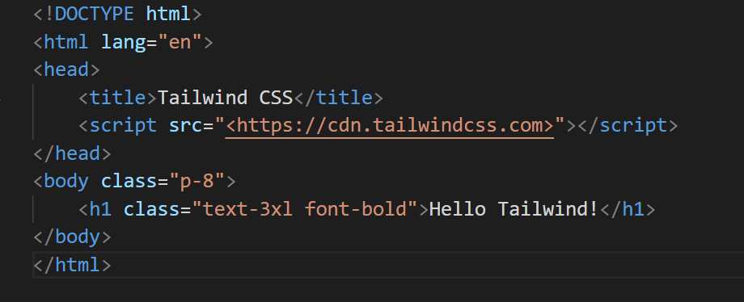
Setting Up Tailwind

Slide 5
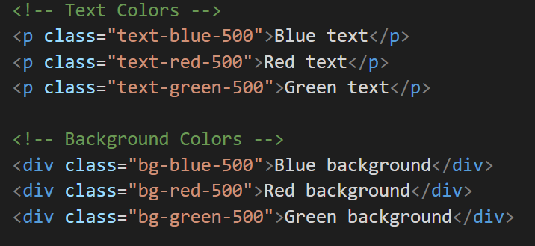
Basic Utilities
Colors:Tailwind provides a default color palette with different shades (50 to 900)

Slide 6
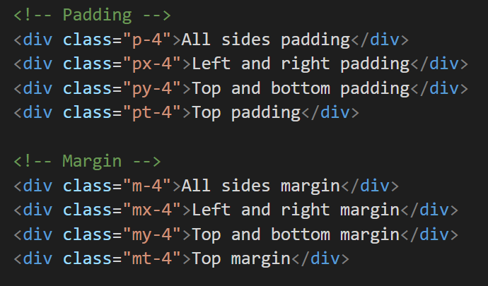
Basic Utilities
Spacing: Margin (m) and Padding (p) with sizes from 0 to 16:

Slide 7
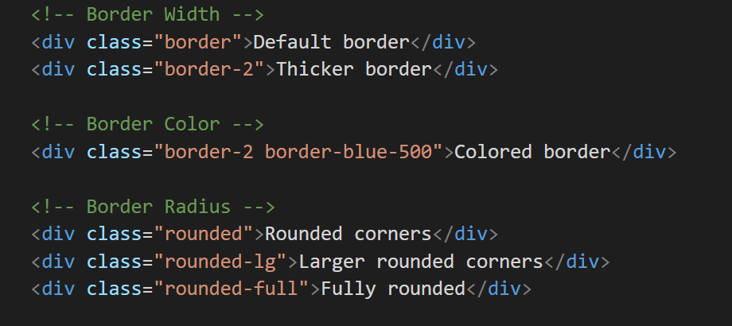
Basic Utilities
Borders:

Slide 8
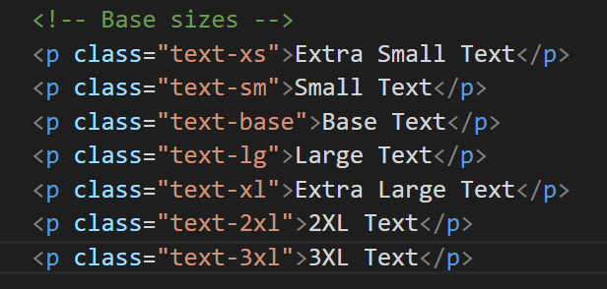
Typography
Font Size:

Slide 9
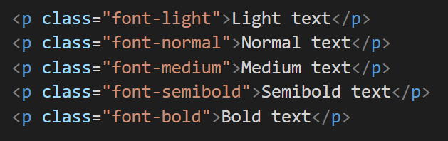
Typography
Font Weight:

Slide 10
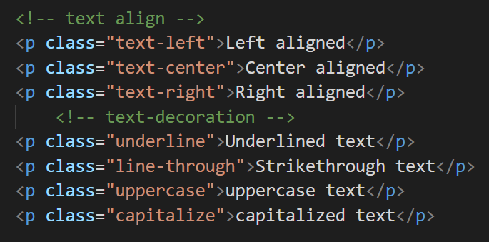
Text Alignment & Decoration

Slide 11
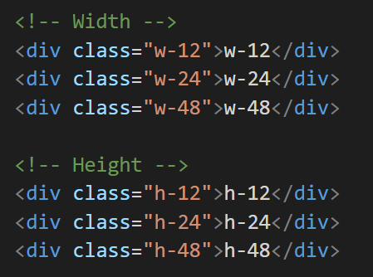
Width and Height

Slide 12
Width and Height
Fixed size:

Slide 13
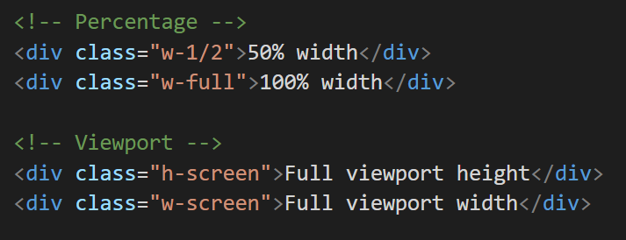
Width and Height
Responsive Sizes:

Slide 14
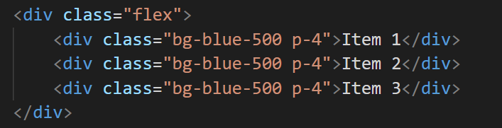
Flexbox
Basic Flex Container:

Slide 15
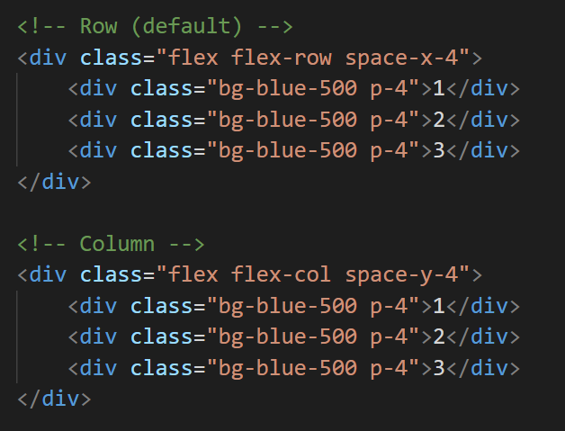
Flexbox
Flex Direction: Row and column

Slide 16
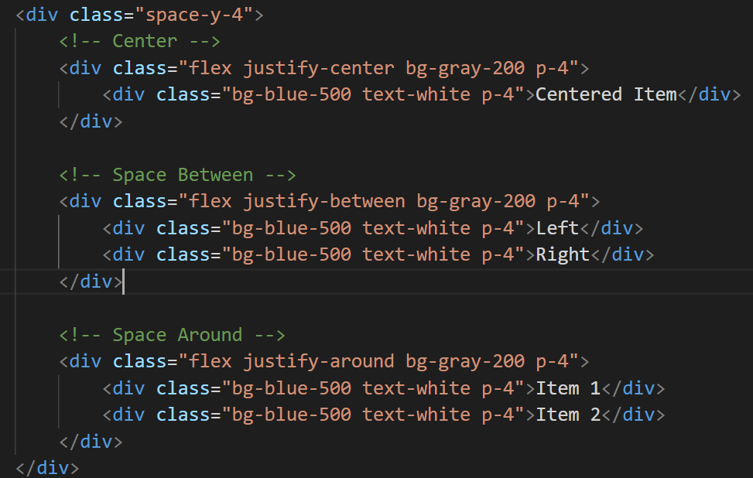
Flexbox
Alignment

Slide 17

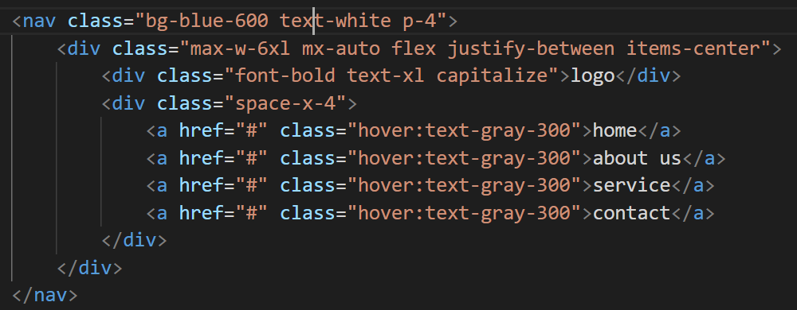
Flexbox

Slide 18
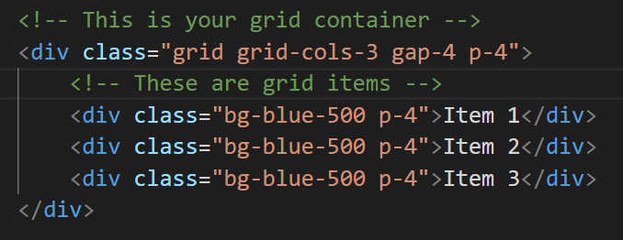
Grid Basics
Grid Container:

Slide 19
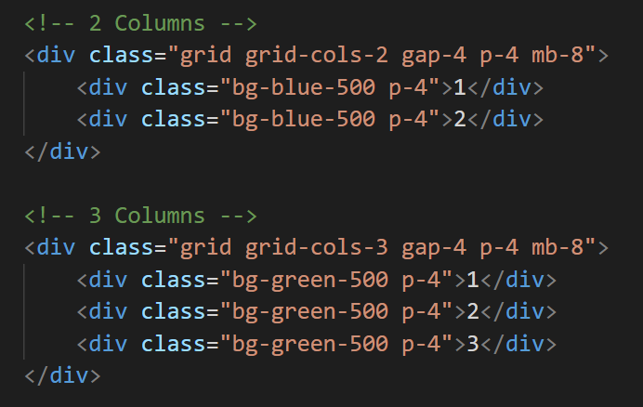
Grid Basics
columns:

Slide 20
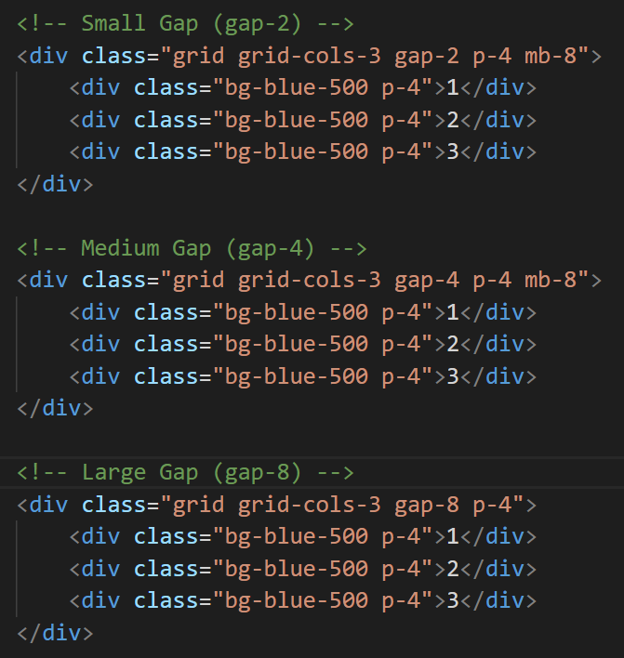
Grid Basics
Difference gap size:

Slide 21
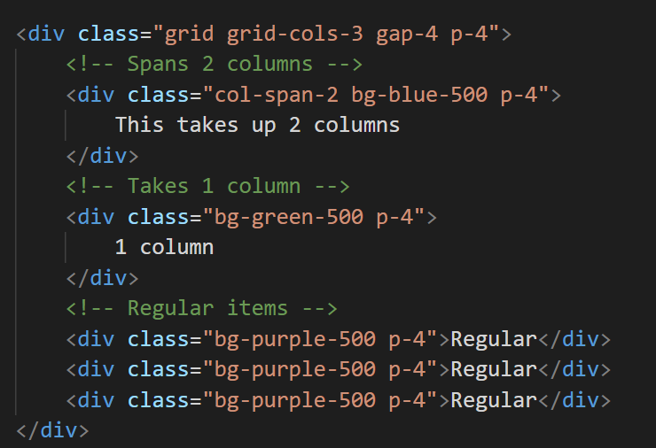
Grid Basics
How Column Spanning Works:

Slide 22
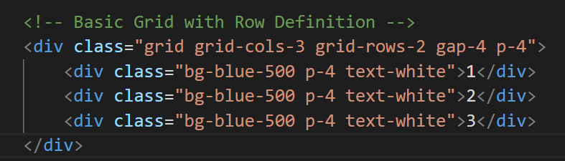
Grid Basics
Grid Rows:

Slide 23
Grid Basics
Grid Rows:

Slide 24
Responsive
Responsive size:
sm: 640px (Small screens, phones)
md: 768px (Medium screens, tablets)
lg: 1024px (Large screens, laptops)
xl: 1280px (Extra large screens, desktops)
2xl: 1536px (2XL screens)

Slide 25
Responsive
Responsive size:
<!-- Responsive width example -->
<div class="w-full md:w-1/2 lg:w-1/3 p-4 bg-blue-500 text-white">
<!-- This div will be:
- Full width on mobile
- Half width on tablet
- One-third width on desktop -->
</div>

Slide 26
Responsive
Responsive size:
<!-- Responsive width example -->
<div class="w-full md:w-1/2 lg:w-1/3 p-4 bg-blue-500 text-white">
<!-- This div will be:
- Full width on mobile
- Half width on tablet
- One-third width on desktop -->
</div>

Slide 27
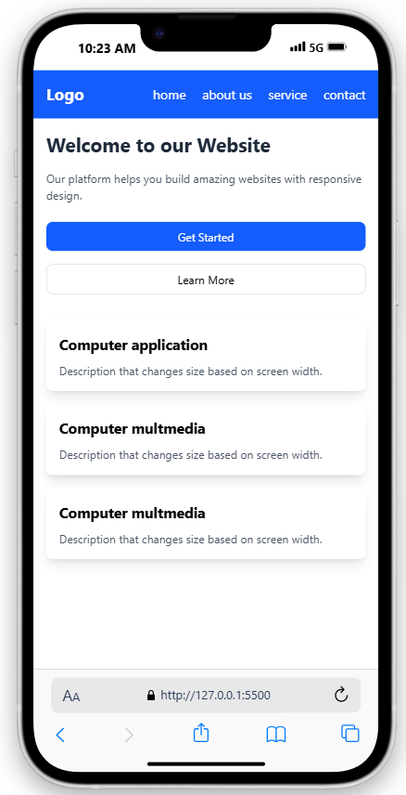
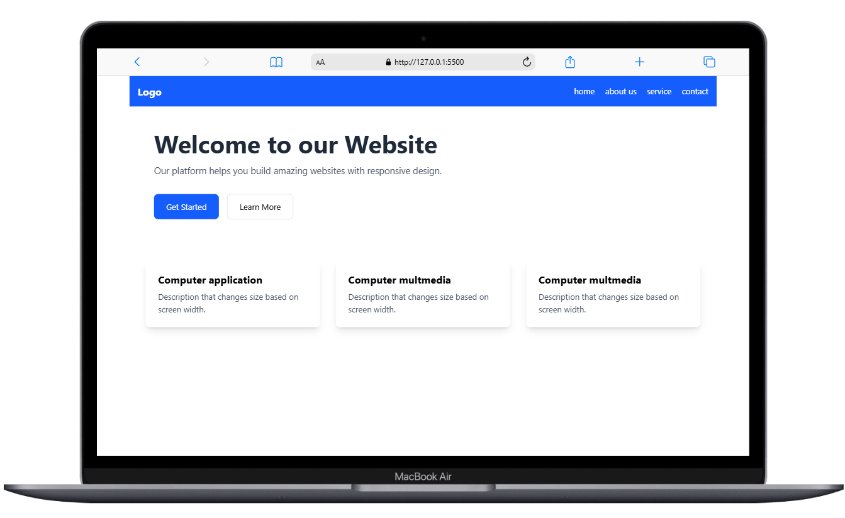
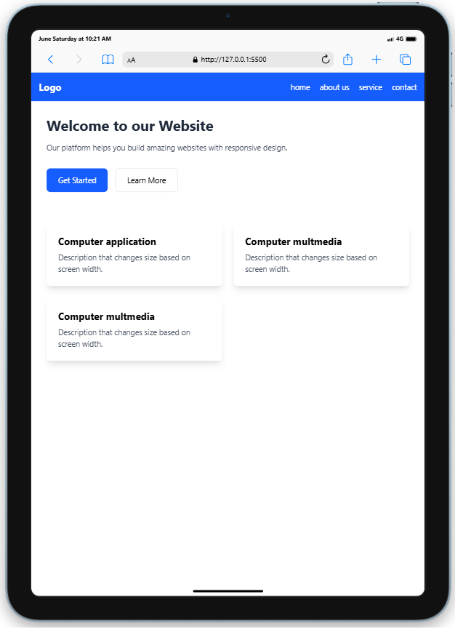
Responsive result

Slide 28
THANKS!
That’s the END.

